Slide 1



Lara’s Quiz

Slide 2
Carrots in History (pre-20th century)
1. Carrots are a domesticated form of which plant?
2. Where were they domesticated?
3. Carrot cultivars are divided between eastern and western, with the western (the orange carrot we know so well) appearing in Europe in the 17th century - but in which country?

Slide 3
Carrots in History (WW2)
4. During the war, carrots were used in various ways, but which of these were carrots really used in?
A drink called carrolade
Jam
Lollies
Cigarettes
Fudge
A substitute for honey
Custard
Marmalade
5. What carrot-related code phrase was used to tell the French Resistance it was D-Day?
6. The idea that carrots help you see in the dark was put about by the UK government to hide the existence of what technology?

Slide 4
Carrot science
7. The medical condition carotenemia, where the palms and soles of the feet turn yellow-orange, is caused by what?
8. Carrots are a good source of what vitamins?
9. True or false: Carrots are better for you when cooked rather than raw.
10. The longest carrot ever was grown by Joe Atherton, in Malvern, UK, on 23 September 2016. How long was it?
11. About 45% of carrots are grown in which country?

Slide 5
Carrots in modern culture (part 1)
12. What sixties science fiction TV show has an episode where Dr Smith is attacked by a giant talking carrot?
13. In what film does a character say "...As God is my witness, I'll never be hungry again." as she takes a carrot from the ground?
14. What American car maker held a banquet in a Detroit hotel with a master of ceremonies dressed in a carrot suit who proclaimed, “I am King Carrota! I am full of vitamins, full of iron, full of iodine, full of bottled sunshine. ....”?

Slide 6
Carrots in modern culture (part 2)
15. The British crime movie, Carrots, featuring Chrissie White as a young female costermonger known as "Carrots" who helps her policeman boyfriend thwart a criminal gang led by her own brother, was released in what year?
16. Name the movie: Attack of the Killer…. ; the plot synopsis in Wiki ends with: The film ends with a carrot that rises from the soil and says, “All right, you guys. They're gone now.”

Slide 7
Answers

Slide 8
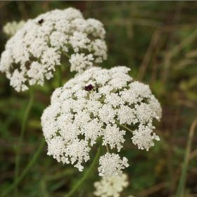
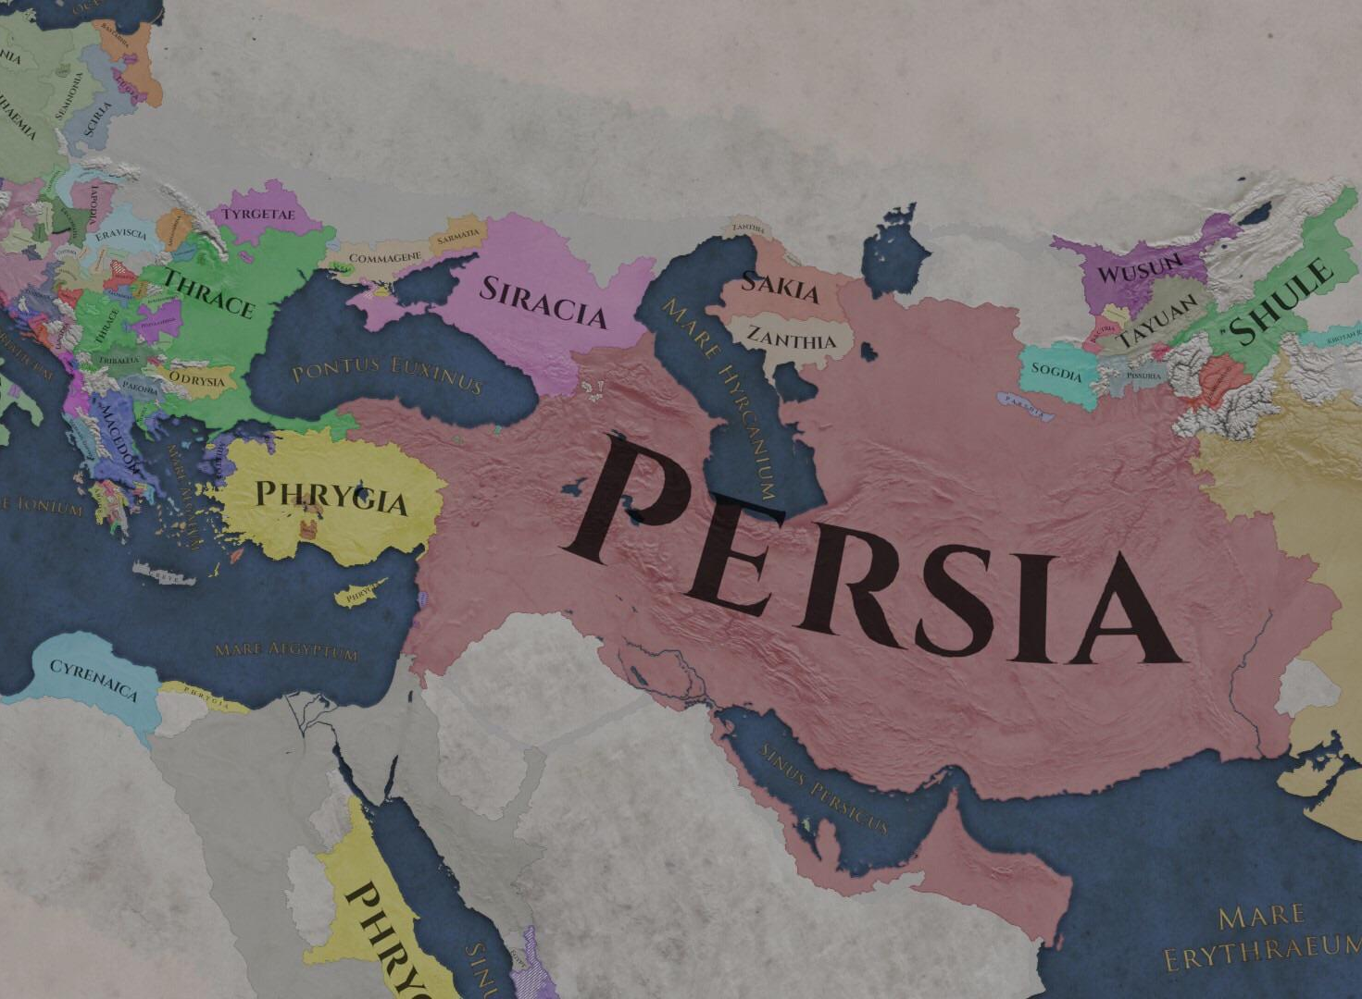
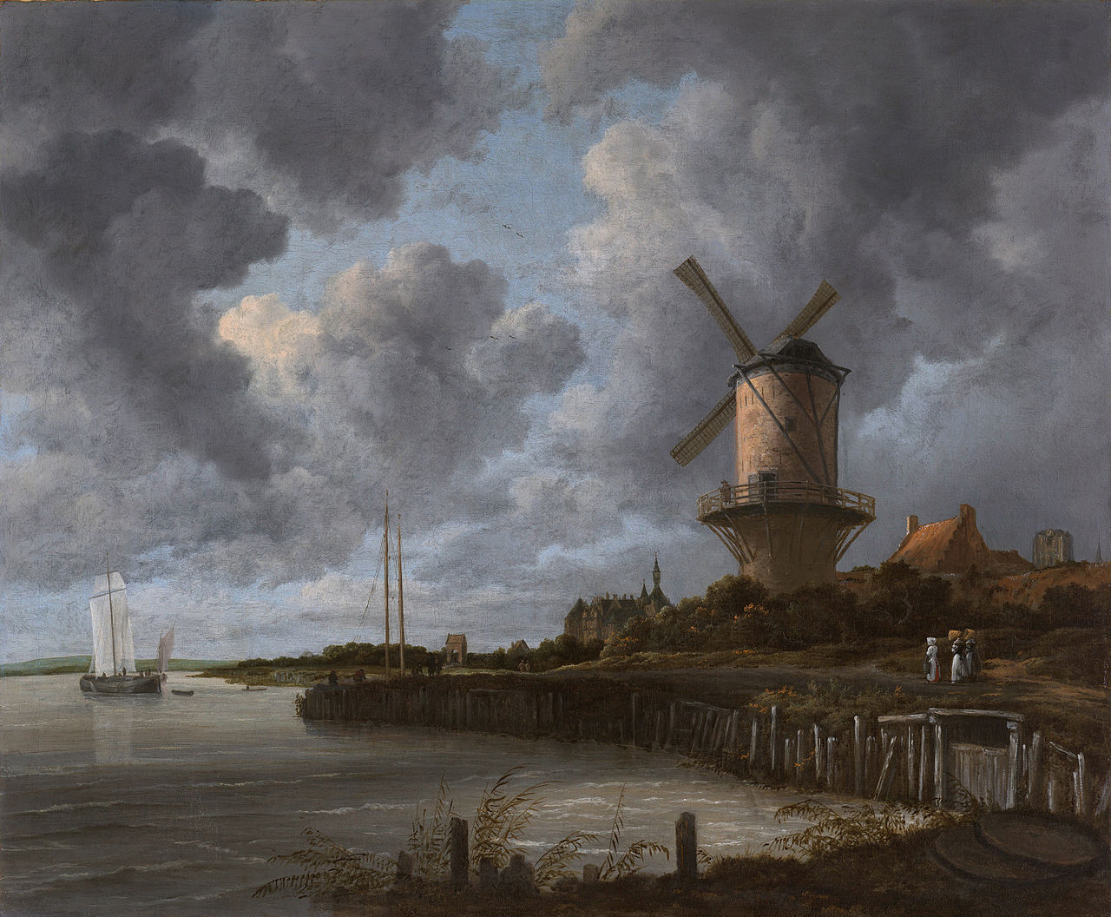
Carrots in History (pre-20th century)
1. Carrots are a domesticated form of which plant?
2. Where were they domesticated?
3. Carrot cultivars are divided between eastern and western with the western – the orange carrot we know so well - appearing in Europe in the 17th century - but in which country?
Wild Carrot
The Netherlands

Slide 9
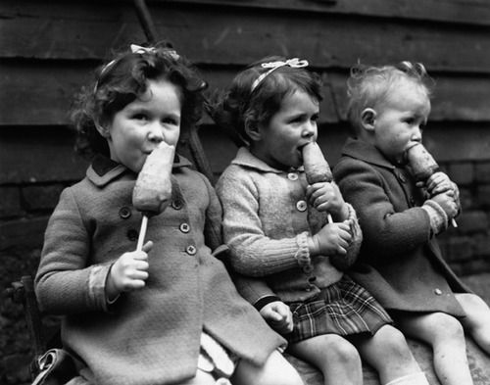
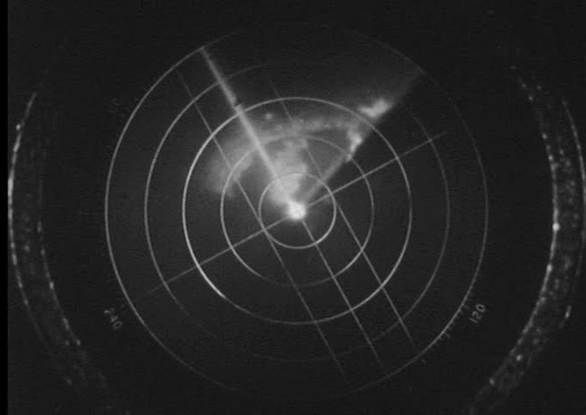
Carrots in History (WW2)
4. During the war, carrots were used in various ways, but which of these were carrots really used in?
A drink called carrolade
Jam
Lollies
Cigarettes
Fudge
A substitute for honey
Custard
Marmalade
5. What carrot-related code phrase was used to tell the French Resistance it was D-Day?
6. The idea that carrots help you see in the dark was put about by the UK government to hide the existence of what technology?
All of them!
“The carrots are cooked”
Radar

Slide 10
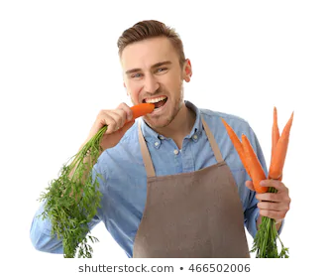

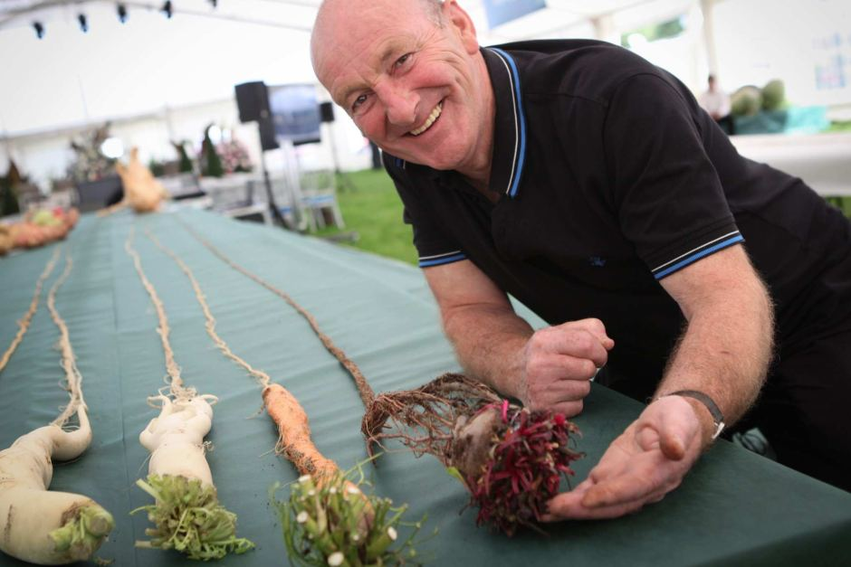

Carrot science
7. The medical condition carotenemia, where the palms and soles of the feet turn yellow-orange, is caused by what?
8. Carrots are a good source of what vitamins?
9. True or false: Carrots are better for you when cooked rather than raw.
10. The longest carrot ever was grown by Joe Atherton, in Malvern, UK, on 23 September 2016. How long was it?
11. About 45% of carrots are grown in which country?
A B C K
Eating too many carrots!
TRUE
20’ 5.9” (6.245m)
China

Slide 11
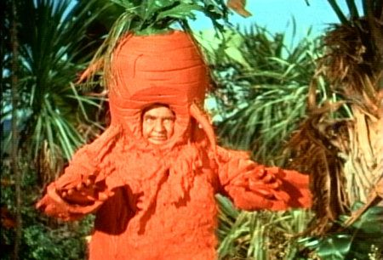
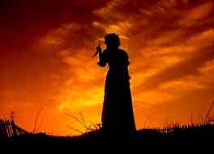
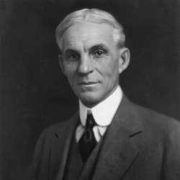
Carrots in modern culture (part 1)
12. What sixties science fiction TV show has an episode where Dr Smith is attacked by a giant talking carrot?
13. In what film does a character say "...As God is my witness, I'll never be hungry again." as she takes a carrot from the ground?
14. What American car maker held a banquet in a Detroit hotel with a master of ceremonies dressed in a carrot suit who proclaimed, “I am King Carrota! I am full of vitamins, full of iron, full of iodine, full of bottled sunshine. ....”?
Lost In Space
Gone With The Wind
Henry Ford

Slide 12
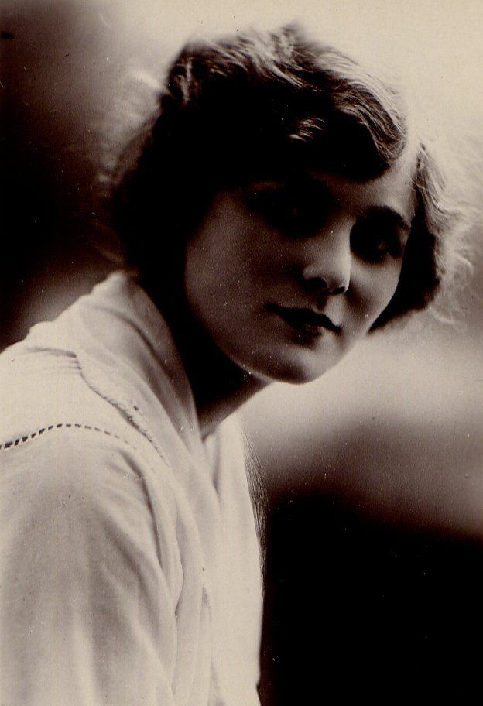
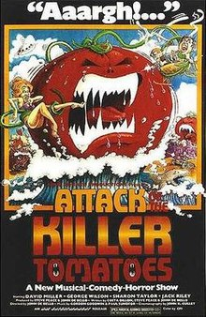
Carrots in modern culture (part 2)
15. The British crime movie, Carrots, featuring Chrissie White as a young female costermonger known as "Carrots" who helps her policeman boyfriend thwart a criminal gang led by her own brother, was released in what year?
16. Name the movie: Attack of the Killer…. ; the plot synopsis in Wiki ends with: The film ends with a carrot that rises from the soil and says, “All right, you guys. They're gone now.”
1917

